Slide 1
Interpretability of DL with Information Theoretic Concepts
Jose C. Principe, Ph.D.
Computational NeuroEngineering Laboratory
University of Florida
principe@cnel.ufl.edu
www.cnel.ufl.edu

Slide 2

Acknowledgments
Dr. John Fisher Dr. Weifeng Liu
Dr. Dongxin Xu Dr. Sohan Seth
Dr. Ken Hild Dr. Badong Chen
Dr. Deniz Erdogmus Dr. Erion Hassanbelliu
Dr. Puskal Pokharel Dr. Luis Sanchez Giraldo
Dr. Weifeng Liu Dr. Austin Brockmeier
Dr. Jianwu Xu Dr. Evan Kriminger
Dr. Kyu-Hwa Jeong Dr. Isaac Sledge
Dr. Sudhir Rao Shujian Yu
Dr. Seungju Han
NSF ECS – 0300340, 0601271, 0856441, 0964197
(Neuroengineering program), DARPA and ONR

Slide 3
Outline
Information Theory (IT) showed the power of entropy and mutual information as scalar descriptors of statistical structure. The abstract nature of information is an asset often forgotten in machine learning (ML).
Our experience shows that IT descriptors improve the conventional algorithms based on second order statistics (optimal filtering, hypothesis tests, similarity functions) with similar computational complexity.
We will also show that IT descriptors are very useful to understand the dynamics of learning and the selection of hyper parameters in Deep Neural Networks.
Finally, we show new applications to Reinforcement learning of little known theory of the Value of Information (VoI) developed by Rustan Stratonovich in the 70’s.

Slide 4
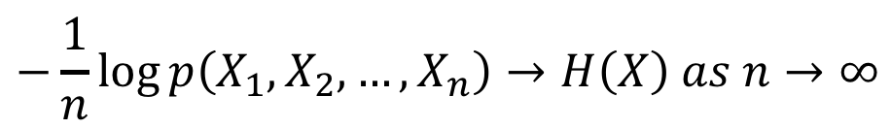
Information Theory Entropy
Not all random variables (r.v.) are equally random!
Entropy quantifies the degree of uncertainty in a r.v. Claude Shannon defined entropy as
Asymptotic Equipartition Property:
Realizations of random variables can be roughly divided in two sets: one that is equally likely with cardinality given by the entropy of the r.v., and the other with a vanishing cardinality.
1
(x)
0.5
f
x
0
5
-5
0
0.4
(x)
f
x
0.2
0
-5
0
5
x
$$−\frac{1}{n}\log{p\left(X_{1}, X_{2},…,X_{n}\right)→H\left(X\right) as n→∞}$$

Slide 5
Online model building
Yakov Tsypkin’s taxonomy of optimal learning problems (1971).
Deterministic - f(x), (Pontryagin maximum principle)
Stochastic - E[f(x)], (Hamilton Jacobi Bellman eq.)
Adaptive – estimate statistics and then E[f(x)].
The third problem learns incrementally the statistics of the data in an online environment for optimization. So should capture the statistical structure online as well as possible.
We call the overall procedure Information Theoretic Learning (ITL). Since in ITL input data are often continuous and the PDF unknown, the role of non-parametric estimators is crucial.
This is the most distinguishing difference of ITL versus Information Theory as applied to the design of communication systems.
Tsypkin Ya. Adaptation and Learning in Automatic Systems, Vol 73, Academic Press, 1971

Slide 6
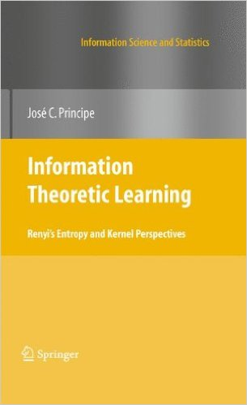
Information Filtering: From Data to Information
Information Filters: Given data pairs {x_{i},d_{i}} find the best linear/ nonlinear projector based on an information measure.
Replace the risk functional in Bayes by plus a bias to center the error variable at zero.
Embed information in the weights of the adaptive system in an online scenario.
Data d_{i}
f(x_{i},w)
Data x_{i}
Adaptive
System
Output
y_{i}
Error d_{i}-y_{i}=e_{i}
-
+
Information
Measure
Information
Learning
Algorithm

Slide 7
Information Theoretic Learning Renyi’s Entropy
Norm of the pdf:
Renyi’s entropy becomes Shannon’s as
V_{α}=α-Information Potential

Slide 8
Information Theoretic Learning Quadratic Renyi’s Entropy (Information Potential)
V₂(x), 2-norm of the pdf (IP) is the central concept in ITL.
E[p(x)]
and
estimators
Information
Theory
(Renyi’s entropy)
Cost functions for
adaptive systems
Reproducing Kernel Hilbert spaces

Slide 9
Minimum Error Entropy MEE A nonmetric cost function for learning
Let us look at the cost given by the α=2 PDF norm (Information Potential)
MEE is a non metric cost. Need an extra
parameter to center the error at zero.
m
p(e)
m
p(e)
E[m]
E[m]
m
p(e)
e
E[m]
e

Slide 10
Information Theoretic Learning Parzen windowing
Given samples drawn according to a distribution:
Convergence:
Estimator is efficient, but its efficiency depends on the data dimensionality.
1
1
N=10
N = 1000
(x)
0.5
(x)
0.5
f
x
f
x
Kernel function
0
0
-5
0
5
-5
0
5
x
x
0.4
N=10
0.4
N = 1000
(x)
(x)
f
x
0.2
f
x
0.2
0
0
-5
0
5
-5
0
5
x
x

Slide 11
Information Theoretic Learning Information Potential Estimation
Quadratic entropy & Gaussian kernels:
Pairwise interactions
between samples
O(N²)
Information potential estimator,
Data creates a potential field over the space of the samples parameterized by the kernel size σ, which is a free parameter
Principe, Fisher, Xu, Unsupervised Adaptive Filtering, (S. Haykin), Wiley, 2000.

Slide 12
Information Theoretic Learning Information Force
For adaptation there is NO need for the logarithm---- just IP(x)
Adaptation softens the IP(x) estimation problem because we are only interested in the cost function’s extrema (not the actual value).
The kernel size σ can be adapted as an extra parameter.
In adaptation, samples become information particles that interact through information forces.
Information potential field at x_{j}:
Information force:
x_{i}
x_{j}
Principe, Fisher, Xu, Unsupervised Adaptive Filtering, (S. Haykin), Wiley, 2000.
Erdogmus, Principe, Hild, Natural Computing, 2002.

Slide 13
Information Theoretic Learning Minimum Error Entropy (MEE) versus MSE
If steepest descent algorithms are employed for optimization of a linear system
Given a batch of N samples the error IP is
For an FIR the gradient becomes
A stochastic gradient approximation (O(L)) for EEC
For L=1
Comparing with LMS
Notes:
(obviously) This also works also for linear systems

Slide 14
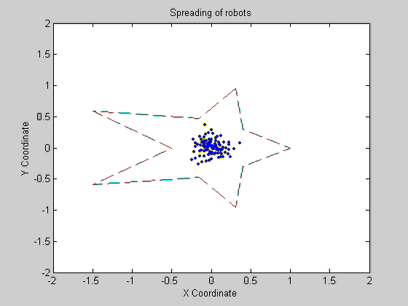
Information Theoretic Learning Backpropagation of Information Forces
Desired
Input
Adaptive
System
IT
Criterion
Output
Information
Forces
Adjoint
Network
Weight
Updates
Information forces become the injected error to the dual or adjoint network that determines the weight updates for adaptation.

Slide 15
Relation Between Minimum Error Entropy and Conventional Costs
For Gaussian situations, the MEE criterion is equivalent to the MSE criterion
Any error criteria with is equivalent to the error entropy plus a Kullback-Leibler divergence term:
where
We have recently shown that it is possible to perform asymptotic unbiased parameter estimation in additive noise using MEE. But the principle of error entropy minimization still requires much more theoretical and practical work
Chen B., Hu J., Zhu Y., Sun Z., “Information Theoretic Interpretation of Error Criteria” A. Automata Sinica, Vol. 35, No. 10, 2009
Chen B., Liu X., Zhao H., Zheng N., Principe J.,” Insights into the Robustness of Minimum Error Entropy Estimation”, IEEE Trans. Neural Net. Learning Systems, Volume: 29, Issue: 3, 731-737 March 2018.

Slide 16
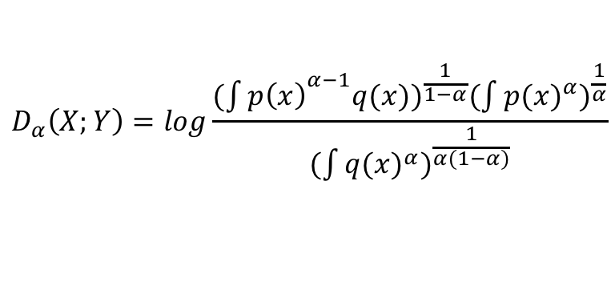
Information Theoretic Learning Quadratic distance measures in probability spaces
Kulback-Liebler
Divergence:
Renyi’s Divergence:
Renyi’s Relative Entropy :
Euclidean Distance :
Cauchy-Schwarz
divergence:
$$D_{α}\left(X;Y\right)=log\frac{{(\int{p\left(x\right)}}^{α−1}{q(x))}^{\frac{1}{1−α}}(\int{{p(x)}^{α})^{\frac{1}{α}}}}{(\int{{q(x)}^{α})^{\frac{1}{α(1−α)}}}}$$
2. J. C. Principe, Information theoretic learning: Renyi’s entropy and kernel perspectives. Springer Science & Business Media, 2010.
3. E. Lutwak, D. Yang, and G. Zhang, “Cramer-rao and moment entropy inequalities for renyi entropy and generalized fisher information,” IEEE Transactions on Information Theory, vol. 51, no. 2, pp. 473–478, 2005.

Slide 17
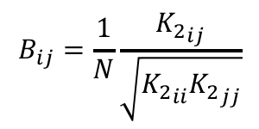
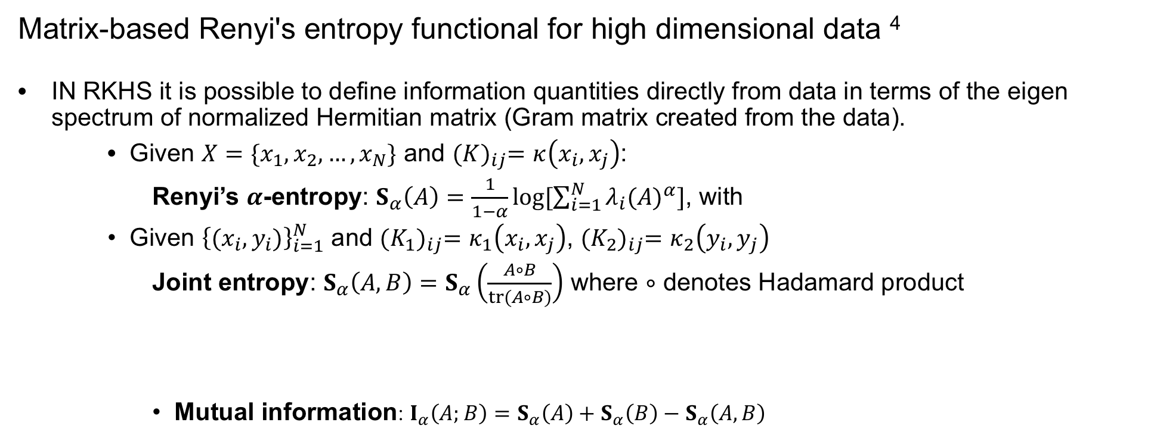
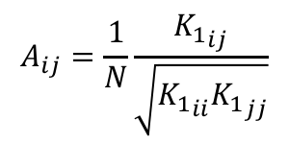
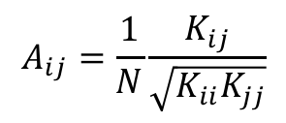
Estimation of Information Theoretic Quantities High dimensional data
Matrix-based Renyi's entropy functional for high dimensional data ⁴
IN RKHS it is possible to define information quantities directly from data in terms of the eigen spectrum of normalized Hermitian matrix (Gram matrix created from the data).
Given $X=\{x_{1},x_{2},…,x_{N}\}$ and ${(K)}_{ij}=κ\left(x_{i},x_{j}\right)$:
Renyi’s $α$-entropy: $S_{α}\left(A\right)=\frac{1}{1−α}\log{[\sum_{i=1}^{N}{λ_{i}{(A)}^{α}}]}$, with
Given ${\left\{(x_{i}, y_{i})\right\}}_{i=1}^{N}$ and ${(K_{1})}_{ij}=κ_{1}\left(x_{i},x_{j}\right)$, ${(K_{2})}_{ij}=κ_{2}\left(y_{i},y_{j}\right)$
Joint entropy: $S_{α}\left(A,B\right)=S_{α}\left(\frac{A∘B}{tr(A∘B)}\right)$ where $∘$ denotes Hadamard product
Mutual information: $I_{α}\left(A;B\right)=S_{α}\left(A\right)+S_{α}\left(B\right)−S_{α}\left(A,B\right)$
$$A_{ij}=\frac{1}{N}\frac{K_{ij}}{\sqrt{K_{ii}K_{jj}}}$$
$$A_{ij}=\frac{1}{N}\frac{{K_{1}}_{ij}}{\sqrt{{K_{1}}_{ii}{K_{1}}_{jj}}}$$
$$B_{ij}=\frac{1}{N}\frac{{K_{2}}_{ij}}{\sqrt{{K_{2}}_{ii}{K_{2}}_{jj}}}$$
4. Giraldo, Luis, Rao Murali, and Jose C. Principe. "Measures of entropy from data using infinitely divisible kernels." IEEE Transactions on Information Theory 61, no. 1 (2015): 535-548.

Slide 18
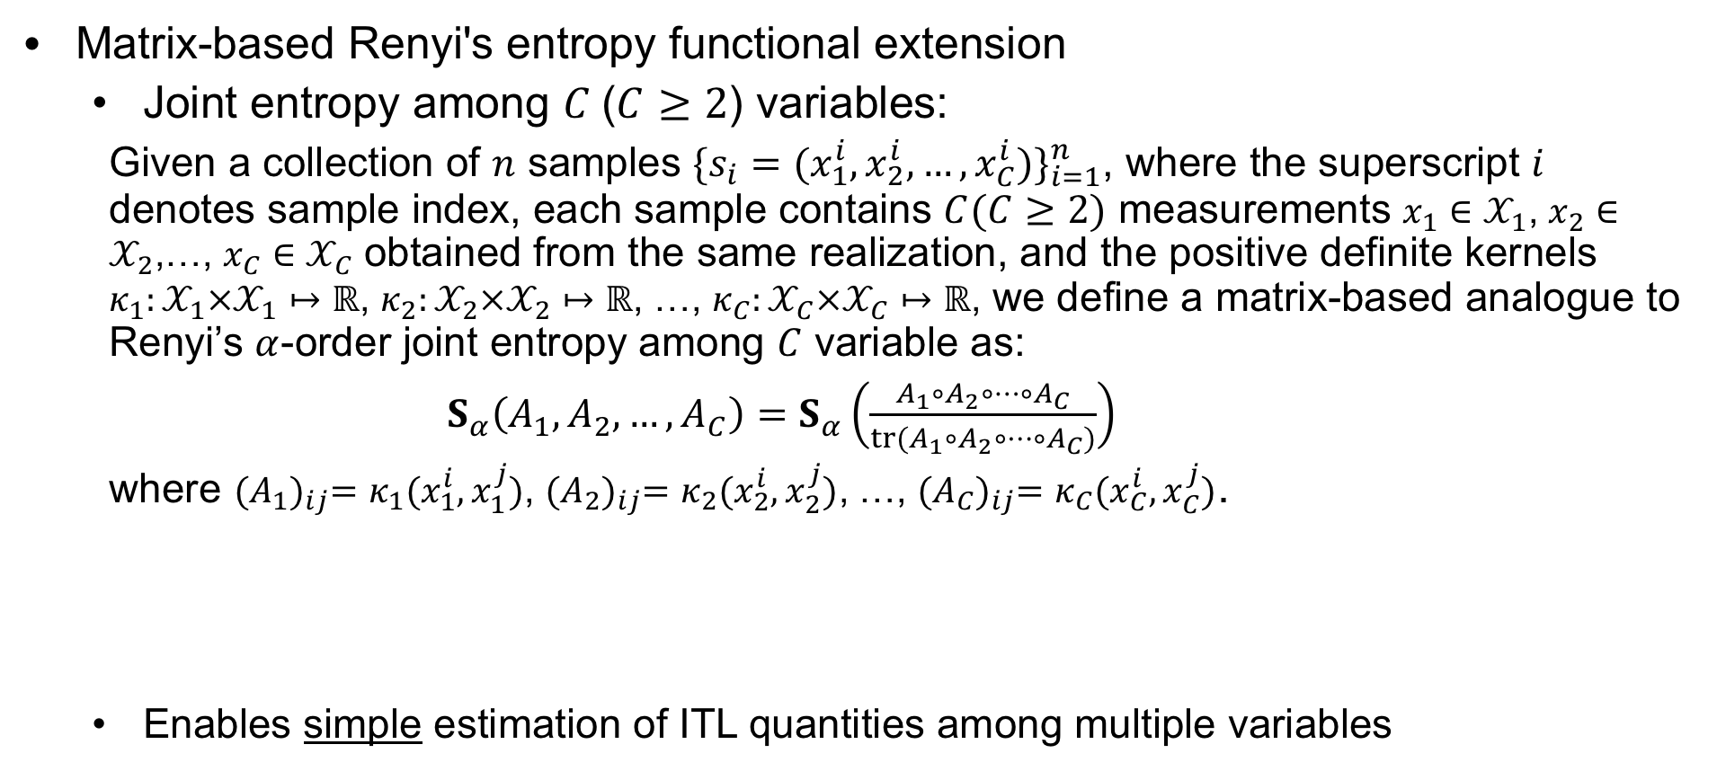
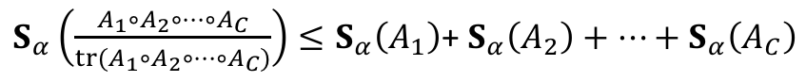
Estimation of Information Theoretic Quantities Joint entropy for multiple variables
Matrix-based Renyi's entropy functional extension
Joint entropy among $C$($C≥2$) variables:
Given a collection of $n$ samples ${\{s_{i}=(x_{1}^{i},x_{2}^{i},…,x_{C}^{i})\}}_{i=1}^{n}$, where the superscript $i$ denotes sample index, each sample contains $C(C≥2)$ measurements $x_{1}∈𝒳_{1}$, $x_{2}∈𝒳_{2}$,…, $x_{C}∈𝒳_{C}$ obtained from the same realization, and the positive definite kernels $κ_{1}:𝒳_{1}×𝒳_{1}↦ℝ$, $κ_{2}:𝒳_{2}×𝒳_{2}↦ℝ$, …, $κ_{C}:𝒳_{C}×𝒳_{C}↦ℝ$, we define a matrix-based analogue to Renyi’s $α$-order joint entropy among $C$ variable as:
${ S}_{α}\left(A_{1},A_{2},…,A_{C}\right)=S_{α}\left(\frac{A_{1}∘A_{2}∘…∘A_{C}}{tr(A_{1}∘A_{2}∘…∘A_{C})}\right)$+
where ${(A_{1})}_{ij}=κ_{1}(x_{1}^{i},x_{1}^{j})$, ${(A_{2})}_{ij}=κ_{2}(x_{2}^{i},x_{2}^{j})$, …, ${(A_{C})}_{ij}=κ_{C}(x_{C}^{i},x_{C}^{j})$.
Enables simple estimation of ITL quantities among multiple variables
$S_{α}\left(\frac{A_{1}∘A_{2}∘…∘A_{C}}{tr(A_{1}∘A_{2}∘…∘A_{C})}\right)≤S_{α}\left(A_{1}\right)$+ $S_{α}\left(A_{2}\right)+…+S_{α}\left(A_{C}\right)$
theoretical guarantee
$S_{α}\left(\frac{A_{1}∘A_{2}∘…∘A_{C}}{tr(A_{1}∘A_{2}∘…∘A_{C})}\right)≥max⁡[S_{α}\left(A_{1}\right)$, $S_{α}\left(A_{2}\right),…,S_{α}\left(A_{C}\right)$]
Yu S., Sanchez Giraldo L., Principe J., ”Multivariate Extension of Matrix-based Renyi’s α Entropy Functional”, in Preparation

Slide 19
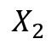
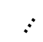
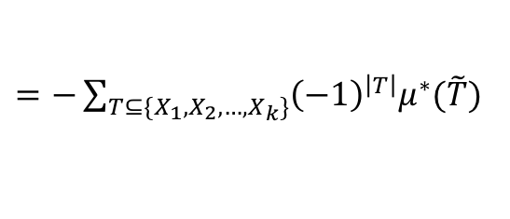
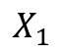
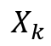
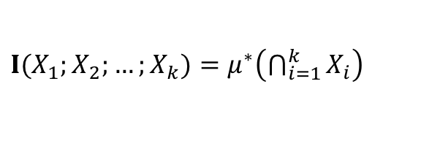
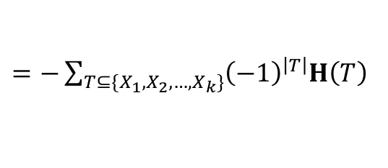
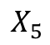
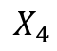
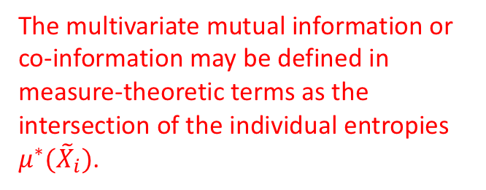
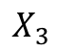
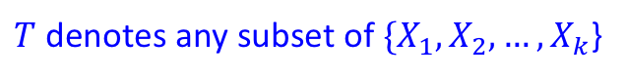
Measuring interactions among multiple variables
A set-theoretic perspective of Shannon’s entropy
Easy to define multivariate interactions between multiple variables
$$X_{1}$$
$$X_{k}$$
The multivariate mutual information or co-information may be defined in measure-theoretic terms as the intersection of the individual entropies $μ^{∗}({\tilde{X}}_{i})$.
$$…$$
$$X_{5}$$
$$X_{2}$$
$$X_{4}$$
$$X_{3}$$
$T$ denotes any subset of $\{X_{1},X_{2},…,X_{k}$}
Venn Diagram of interaction among $k$ ($k≥3$) variables
$I(X_{1};X_{2};…;X_{k})=μ^{∗}\left(\bigcap_{i=1}^{k}{X_{i}}\right)$
$=−\sum_{T⊆\{X_{1},X_{2},…,X_{k}\}}{{\left(−1\right)}^{\left|T\right|}μ^{∗}(\tilde{T})}$
$=−\sum_{T⊆\{X_{1},X_{2},…,X_{k}\}}{{\left(−1\right)}^{\left|T\right|}H\left(T\right)}$

Slide 20
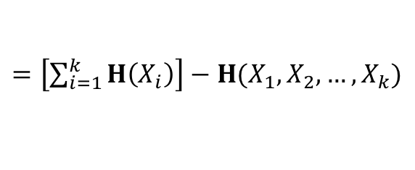
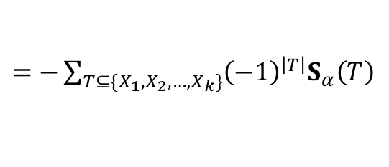
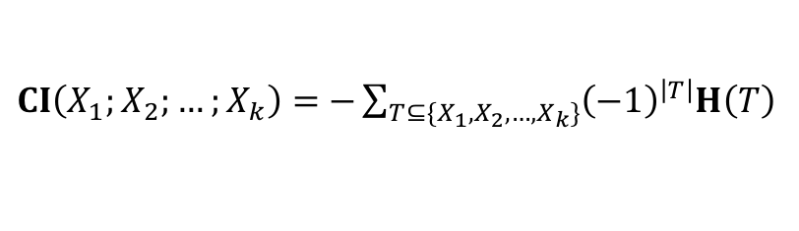
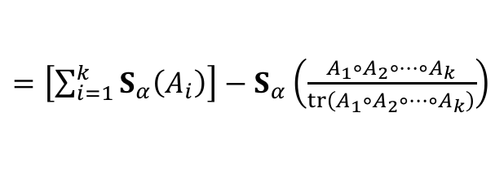
Measuring interactions among multiple variables
Multivariate Interactions using matrix-based Renyi’s entropy
Co-information
$CI\left(X_{1};X_{2};…;X_{k}\right)=$ $−\sum_{T⊆\{X_{1},X_{2},…,X_{k}\}}{{\left(−1\right)}^{\left|T\right|}H\left(T\right)}$
$=$ $−\sum_{T⊆\{X_{1},X_{2},…,X_{k}\}}{{\left(−1\right)}^{\left|T\right|}S_{α}\left(T\right)}$
Value of co-information (CI) may be negative. Positive CI signifies synergy, where negative CI signifies redundancy.
Total correlation: the KL divergence between joint distribution and product of marginal distributions
$$TC\left(X_{1};X_{2};…;X_{k}\right){≡D}_{KL}(P(X_{1},X_{2},…,X_{k})||P\left(X_{1}\right)P\left(X_{2}\right)…P\left(X_{k}\right))$$
$=\left[\sum_{i=1}^{k}{H\left(X_{i}\right)}\right]−H(X_{1},X_{2},…,X_{k})$
$=\left[\sum_{i=1}^{k}{S_{α}\left(A_{i}\right)}\right]−S_{α}\left(\frac{A_{1}∘A_{2}∘…{∘A}_{k}}{tr\left(A_{1}∘A_{2}∘…{∘A}_{k}\right)}\right)$
Total correlation is zero if and only if all variables are mutually independent.
Mutual information between $Y$ and a group of variables $\{X_{1},X_{2},…,X_{k}\}$
$I\left({Y;\{X}_{1},X_{2},…,X_{k}\}\right)=$ $S_{α}\left(B\right)+$ $S_{α}\left(\frac{A_{1}∘A_{2}∘…{∘A}_{k}}{tr\left(A_{1}∘A_{2}∘…{∘A}_{k}\right)}\right)−S_{α}\left(\frac{A_{1}∘A_{2}∘…{∘A}_{k}∘B}{tr\left(A_{1}∘A_{2}∘…{∘A}_{k}∘B\right)}\right)$
This expression is easy to apply in lots of applications.

Slide 21
Understanding Deep Neural Networks with ITL Motivation
Deep neural networks (DNNs) are an unquestionable success story for certain types of sensory applications such as
Image classification, speech recognition, text processing
Overwhelming advantages over statistical machine learning models (e.g., HMM, GMM, LDA) in performance
However, we still know very little on how to properly set the hyper parameters of these huge DNN models, which are treated as Black boxes.
There have been attempts to understand DNNs from physics principles through variational renormalization groups, or mathematical modeling (manifold disentanglement), however we think that simpler ideas of signal processing projections may be more appropriate.

Slide 22

Understanding Deep Neural Networks with ITL Motivation
Most of our DNNs use the same type of processing elements (units), therefore no matter where one looks in the DNN, the processing must be the same!
It is very well known that the sigmoid units are ridge functions in the space created by the previous units outputs, modeled as bases functions.
So a pair of layers creates a projection space and projects the input data. The difficulty is to make sense of learned projections! See my book (2000).

Slide 23
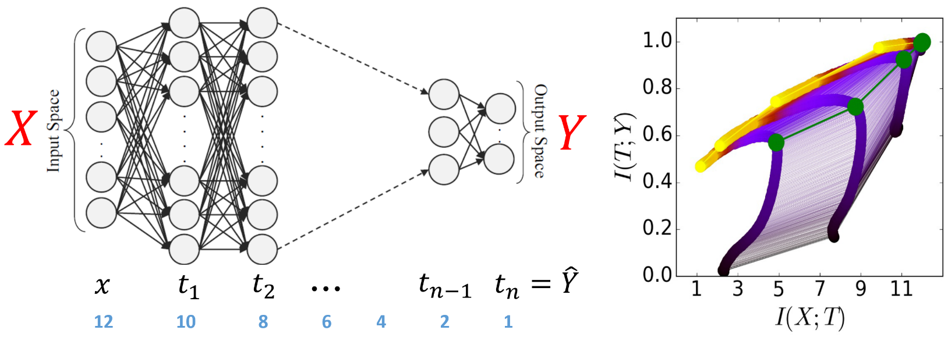
Understanding Deep Neural Networks with ITL Motivation
An important advance was Tishby’s Information Plane proposal to analyze pairwise projected mappings using mutual information.
We see three fundamental needs to practically employ his approach:
The need to estimate mutual information directly from high dimensional data
To generalize cost functions beyond the information bottleneck method.
To apply ITL concepts to select the hyperparameters of learning.
R. Shwartz-Ziv and N. Tishby, “Opening the black box of deep neural networks via information,” arXiv preprint arXiv:1703.00810, 2017

Slide 24
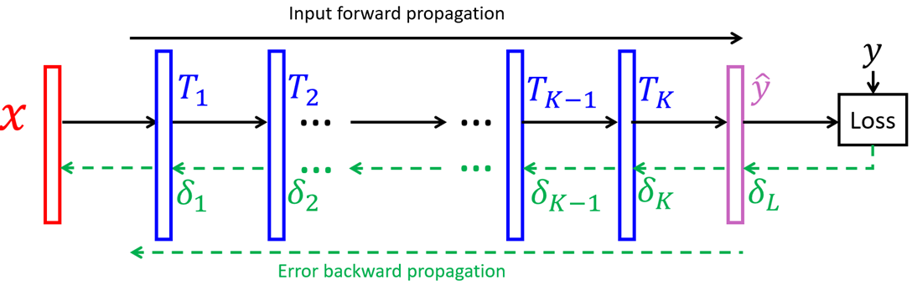
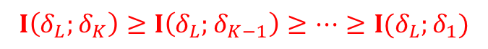
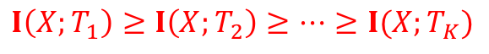
Understanding DNNs with ITL Concepts
In order to apply the information plane to DNNs we must analyze the statistical transformations in a DNN during learning. We restrict our study to feedforward networks to apply the Data Processing Inequality (DPI), which requires a Markov Assumption.
There are two fundamental DPIs in feed-forward DNNs during BP learning:
one for activations, the other for errors, in opposite directions.
$$X→T_{1}→T_{2}→…→T_{K−1}→T_{k}$$
$$I\left(X;T_{1}\right)≥I\left(X;T_{2}\right)≥…≥I(X;T_{K})$$
$$δ_{L}→δ_{K}→δ_{K−1}→…→δ_{2}→δ_{1}$$
$$I\left(δ_{L};δ_{K}\right)≥I\left(δ_{L};δ_{K−1}\right)≥…≥I(δ_{L};δ_{1})$$

Slide 25
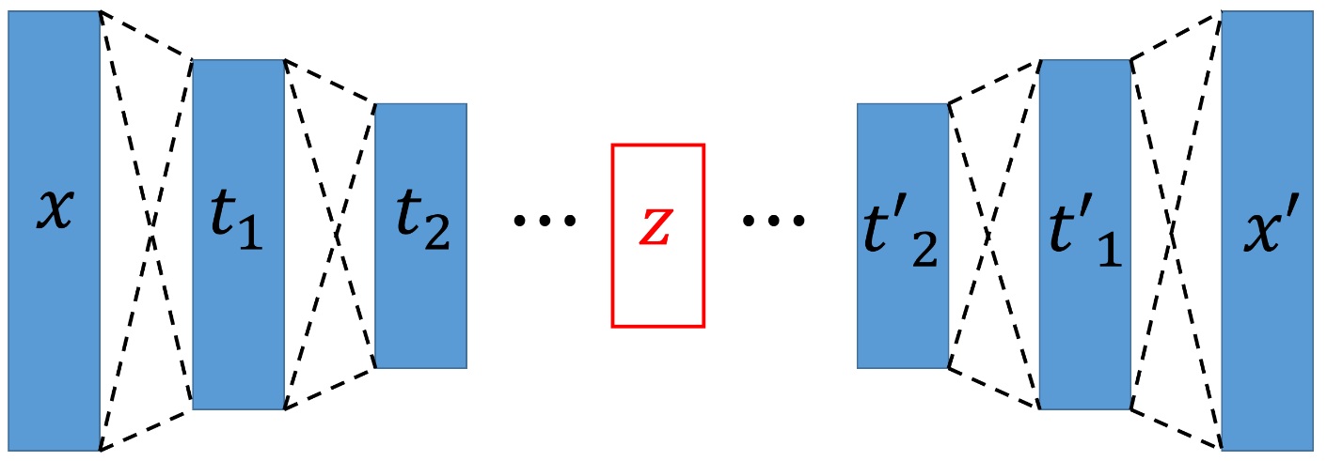
Understanding DNNs with ITL Concepts - SAE
There are DNNs besides MLPs with special topologies. Here we will study the stacked auto encoder (SAE), which is an interesting architecture that resembles a communication channel. The output is trained to be equal to the input, and in the bottleneck layer one can add noise to mimic the real communication channel.
An interesting question is: can the SAE learn noise free transmission as well as coding theory?
Encoder Linear Decoder
Stacked Autoencoder

Slide 26
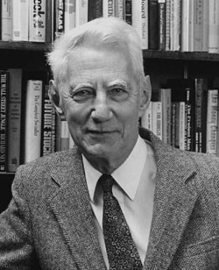
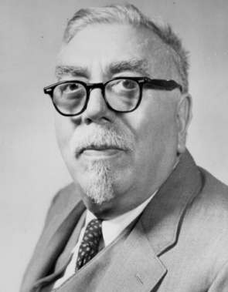
Understanding DNNs with ITL Concepts - SAE
Shannon's perspective¹: Given the statistical properties, e.g., probability of density function (pdf), of signal, noise as well as communication channel, with an appropriate encoding-decoding scheme, it is always possible to communicate discrete digital information error-free, no matter the degree of noise contamination.
Wiener's perspective²: Given only the signal information, attenuate noise from signal via modeling using the cost to make the transmission error as small as possible.
 | Shannon | Wiener
Condition | complete statistical properties of are given. | Only signal is given.
Method | encoding-decoding scheme | minimizing mean square errors (MSE)
Expectation | error-free | least distortion
1. C. E. Shannon, “A Mathematical Theory of Communication,” The Bell System Technical Journal, vol. 27, no. 3, pp. 379–423, 1948.
2. N. Wiener, Extrapolation, Interpolation, and Smoothing of Stationary Time Series. MIT press Cambridge, 1949, vol. 2.

Slide 27
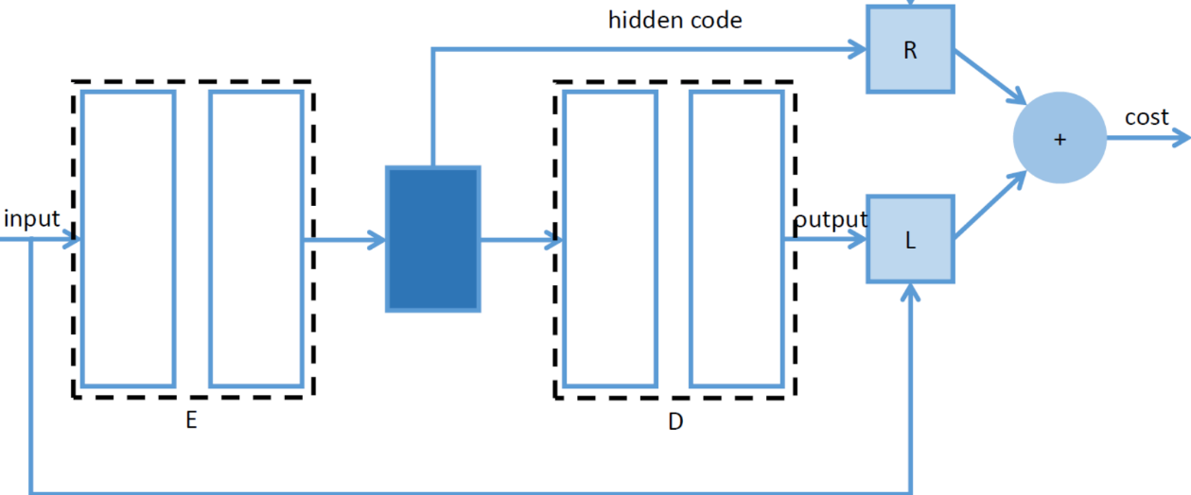
Understanding DNNs with ITL Concepts - SAE
Autoencoder regularized with principle of relevant information (PRI-AE)
Created a constellation in the bottleneck layer to organize the input into separated clusters
regularization term combined with pdf estimation:
Shannon’s perspective
error minimization term:
Wiener’s perspective

Slide 28
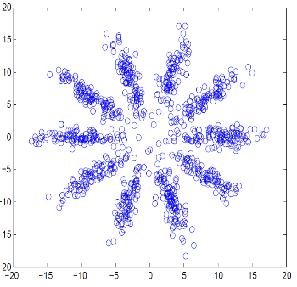
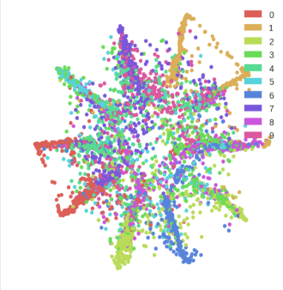
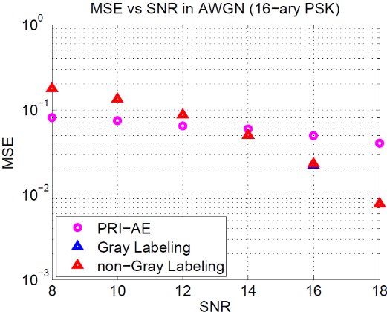
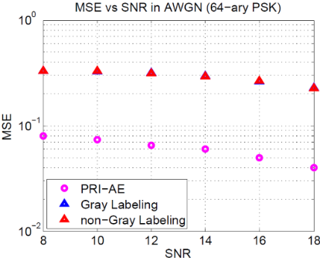
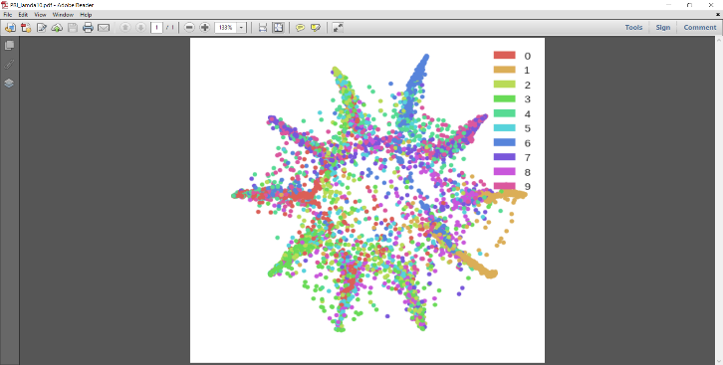
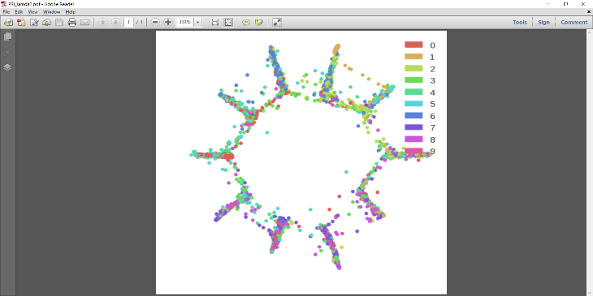
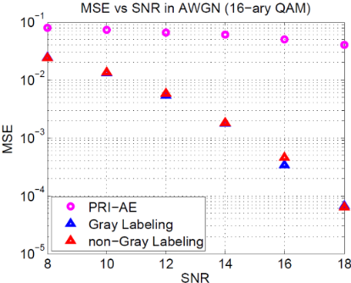
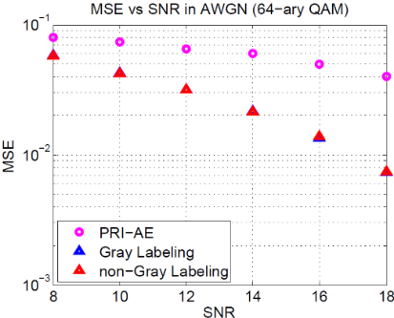
Understanding DNNs with ITL Concepts - SAE
Image (MNIST) transmission under noisy conditions (8-18 dB).SAE was trained with no noise. Evaluation over 100 test images (MSE). For transmission images were coded with BCH codes.
(a)
(b)
(a)
(b)
(c)
(d)
Hidden code visualization using (a) the mixture of 10 Gaussians prior; PRI-AE with (b)
(c) and (d) for MNIST database.
(c)
(d)
Yu S., Emigh M., Santana E., Principe J., “Autoencoders trained with relevant information: Blending Shannon and Wiener’s”, Proc. IEEE ICASSP 2017, New Orleans, Louisiana

Slide 29
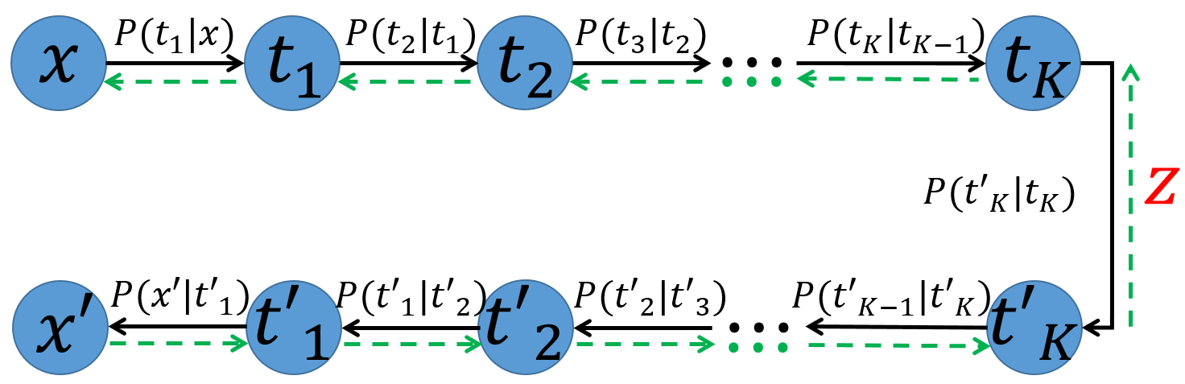
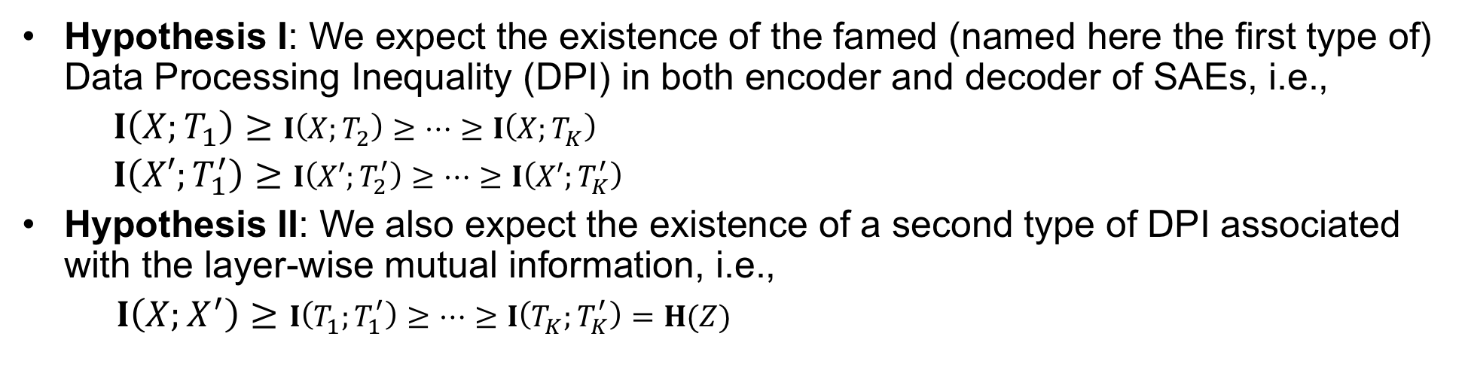
Understanding DNNs with ITL Concepts - SAE
Hypothesis I: We expect the existence of the famed (named here the first type of) Data Processing Inequality (DPI) in both encoder and decoder of SAEs, i.e.,
$I\left(X;T_{1}\right)≥I\left(X;T_{2}\right)≥…≥I\left(X;T_{K}\right)$
$I\left(X′;T_{1}^{′}\right)≥I\left(X′;T_{2}^{′}\right)≥…≥I\left(X′;T_{K}^{′}\right)$
Hypothesis II: We also expect the existence of a second type of DPI associated with the layer-wise mutual information, i.e.,
$I\left(X;X^{′}\right)≥I\left(T_{1};T_{1}^{′}\right)≥…≥I\left(T_{K};T_{K}^{′}\right)=H(Z)$
Two
Markov Chains
5. Yu, Shujian, and Jose C. Principe. "Understanding Autoencoders with Information Theoretic Concepts." arXiv preprint arXiv:1804.00057 (2018).

Slide 30
Understanding DNNs with ITL Concepts - SAE
Empirical Validation of Hypothesis I & II of SAEs
Data set: MNIST (60,000 images, 28x28 pixels)
Architecture:
$$I\left(X;X^{′}\right)≥I\left(T_{1};T_{1}^{′}\right)≥…≥I\left(T_{K};T_{K}^{′}\right)=H(Z)$$
784-1000-500-250-36-250-500-1000-784
Pairwise mutual information values between symmetric layers in encoder and decoder
We cannot increase information even using overcomplete representations in hidden layers!

Slide 31
Understanding DNNs with ITL Concepts - SAE
Empirical Validation of Hypothesis I & II of SAEs
Data set: NMIST (60,000 images, 28x28 pixels)
Architecture:
$$I\left(X;X^{′}\right)≥I\left(T_{1};T_{1}^{′}\right)≥…≥I\left(T_{K};T_{K}^{′}\right)=H(Z)$$
784-1000-500-250-2-250-500-1000-784
Pairwise mutual information values between symmetric layers in encoder and decoder
We are continuously losing information with successive layers!

Slide 32
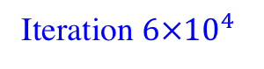
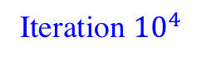
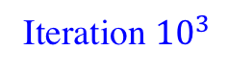
Understanding DNNs with ITL Concepts –SAE
Geometrical distribution of codes in the bottleneck layer
784-1000-500-250-2-250-500-1000-784
Iteration 1
Iteration ${10}^{3}$
Iteration ${10}^{4}$
Iteration ${6×10}^{4}$

Slide 33
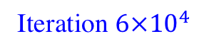
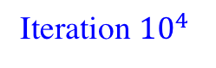
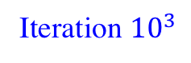
Understanding DNNs with ITL Concepts -SAE
Geometrical distribution of codes in the bottleneck layer
784-1000-500-250-36-250-500-1000-784
Iteration 1
Iteration ${10}^{3}$
Iteration ${10}^{4}$
Iteration ${6×10}^{4}$

Slide 34
Understanding DNNs with ITL Concepts -SAE
Recalling Taken’s embedding theorem, the properties of the projection to the subspace is controlled by the bottleneck layer size, i.e. if it is too small, it can not represent the multi dimensional input data without folding. How will this affect the dynamics of learning in the Information Plane?
Hypothesis III: We expect the existence of a a bifurcation point (different behavior) in the Information Plane across different sizes of the bottleneck layer.
different bottleneck layer size
Pattern I (Imaginary)
Pattern II (Imaginary)

Slide 35

Understanding DNNs with ITL Concepts - SAE
Empirical Validation of Hypothesis III in SAEs
K=2
K=11
The curves in Information Plane demonstrate distinct patterns which is controlled by the bottleneck layer size K.
By Taken’s Theorem, K should be a reliable estimator to the intrinsic dimensionality (ID) of training data. We estimate ID of MNIST $\left[12,14\right]$ (ground truth value is approximately 13).
K=15
K=36

Slide 36

Understanding DNNs with ITL Concepts - SAE
Intrinsic Dimensionality (ID) estimation on synthetic data with known ID using dynamics of learning (all the layers should display a return in the IP)
The value in parenthesis indicates the real ID. The bottom row reports the Mean Percentage Error (MPE) value (the smaller the better) achieved by each competing method. The best results are marked in bold for each dataset.
Our estimator ranks the 2nd among state-of-the-art competitors.

Slide 37
Understanding DNNs with ITL Concepts - SAE
Can the IP provide evidence to stop training for best generalization?
Trained the same SAE stopping at different parts of the IP curves (color coded). Then used the bottleneck representations as input to a classifier to evaluate the classification accuracy of an SVM. As can be seen when the first layer IP stabilizes and moves back, corresponds to the point where training should stop (close to maximum generalization).

Slide 38

Understanding DNNs with ITL Concepts - CNNs
Convolution neural networks (CNNs) are much more complex than MLPs and SAEs. Many more hyper parameters too!
Does the DPI still hold for CNNs, and how to measure MI(X;T)?
CNNs are built from layers with
multiple convolution masks,
followed by polling layers, aggregated
by nonlinear layers, and downsampled.
First work to estimate and analyze information flow in CNNs!
6. Yu, Shujian, Robert Jenssen, and Jose C. Principe. "Understanding Convolutional Neural Network Training with Information Theory." arXiv preprint arXiv:1804.06537 (2018).

Slide 39









Understanding DNNs with ITL Concepts - CNNs
Flat representation of CNNs and Information Quantities Estimation
$$I\left(X;T\right)=I(X;\{T^{1},T^{2},…,T^{C}\})$$
$$=H\left(X\right)+H(T^{1},T^{2},…,T^{C})$$
$$−H(X,T^{1},T^{2},…,T^{C})$$
$$S_{α}\left(A_{1},A_{2},…,A_{C}\right)=S_{α}\left(\frac{A_{1}∘A_{2}∘…∘A_{C}}{tr(A_{1}∘A_{2}∘…∘A_{C})}\right)$$
Only requires eigenspectrum of Gram matrix of kernel learning, rather than PDF and conditional PDF estimation among multiple high-dimensional variables!
$$I(X;T_{i})$$
$$I(X;T_{i+1})$$

Slide 40
Understanding DNNs with ITL Concepts - CNNs
Empirical Validation of DPIs
The CNN architecture is a LeNet-5 with 6 5×5 filters in the first convolutional layer and 16 5×5 filters in the second convolutional layer and two fully connected layers (thus forming 6 hidden layers). We train the CNN using the basic SGD with mini-batch size 128.
Initial iteration
3 epochs later
10 epochs later

Slide 41
Understanding DNNs with ITL Concepts - CNNs
Are deeper DNNs better?
(a) one convolutional layer, 97.6% (b) two convolutional layers, 97.97% (c) three convolutional layers (fail)
The data processing inequalities (DPIs) in convolutional neural networks (CNNs) trained on MNIST using different network topologies (after 3 epochs). (a) shows the DPIs for a CNN only with 6 filters in the first convolutional layer. (b) shows the DPIs for a CNN with 6 filters in the first convolutional layer and 16 filters in the second convolutional layer. (c) shows the DPIs for a CNN with 6 filters in the first convolutional layer, 16 filters in the second convolutional layer, and 16 filters in the third convolutional layer. The value at the end of each subtitle is the average classification accuracy (%) on testing set (over 10 Monte-Carlo simulations).

Slide 42






Understanding DNNs with ITL Concepts - CNNs
Trade-off: multiple features (C) versus redundancy in convolutional layers, where redundancy is defined as
$R(X;\left\{T^{1},…T^{C}\right\})=\sum_{i=1}^{C}{MI\left(X;T^{i}\right)−MI(X;}$ $\{T^{1},…T^{C}$})
Obviously, the down sampling
step reduces input information
$$\left.H(\{T_{i}^{1}, T_{i}^{2},T_{i}^{3}, T_{i}^{4}\})≥H(\{T_{i+1}^{1}, T_{i+1}^{2},T_{i+1}^{3}, T_{i+1}^{4}\}\right)$$
One of the implications of the
DPI is that the features of top
layers will be more localized
$$\left.I(X;\{T_{i}^{1}, T_{i}^{2},T_{i}^{3}, T_{i}^{4}\})≥I(X;\{T_{i+1}^{1}, T_{i+1}^{2},T_{i+1}^{3}, T_{i+1}^{4}\}\right)$$
The interactions between input $X$ and multiple feature maps in convolutional layer. Sufficient number of filters are necessary, more filters will cause redundancy.

Slide 43
Understanding DNNs with ITL Concepts - CNNs
Pinpoint redundancy in convolutional filters in a two conv layer CNN on MNIST
Sufficient number of filters are necessary, because we need to use synergistic information among filters.
2 filters in C1, 2 filters in C2, 96%
2 filters in C1, 8 filters in C2, 97%
More filters do not always bring performance gain because of redundancy.
6 filters in C1, 16 filters in C2, 97.97%
32 filters in C1, 64 filters in C2, 97.90%

Slide 44
Understanding DNNs with ITL Concepts - CNNs
Need to revisit the explanation of the behavior in the Information Plane!
We failed to see the turn back of IP curves in CNNs during training as occurs in the MLP and SAE.
Information plane on MNIST (sigmoid)
Information plane on Fashion-MNIST (Relu)
Patterns in Information Plane depend on specific DNNs architectures. It is not just a simple matter of activation functions.
More in-depth theory and analysis are required to fully exploit the Information Bottleneck perspective!

Slide 45
Conclusions and future work
The elegant estimation of entropy and mutual information over the eigenspectrum of Gram matrices in RKHS opens the door to practical applications of the Information Plane to evaluate progress of learning.
The IP can also be used to set hyperparameters of topologies (# of layers, # of units in layers, etc.) and help us address the generalization problem in a different perspective.
However, we still do not fully understand nor can state how far this methodology will open the BlackBox of DNNs.
Extension to other deep learning architectures
Recurrent Neural Networks
Fully convolutional networks
Application on other machine learning problems
Feature selection
Multi-view learning

Slide 46
The theory of the Value of Information Ruslan Stratonovich
The value of information connects Shannon's information theory with statistical decision theory, which deal with the concept of average losses or risk to characterize the quality of decisions being made.
Definition: The value of information is the maximum benefit that can be gained by a given quantity of information in order to minimize average losses.
One can use either Hartley’s definition of information, Shannon’s entropy or Mutual Information. The most famous example using entropy is rate distortion theory which minimizes entropy under a certain level of loss.
The use of MI requires an extension to the Bayesian system , i.e. a random variable x distributed as p(x), and a penalty function c(x,u) with u being an external utility.
Stratonovich R., Information Theory, Soviet Radio, 1975

Slide 47
The theory of the Value of Information
For each conditional distribution P(du|x) we can compute average penalties (risk)
as well as the Mutual Information
A conditional distribution is extremal if it corresponds to an extremum of average penalties at a fixed amount of information I_{xu}=I .
We can show that this extremal distribution corresponds to a minimum of I_{xu} under fixed penalties.

Slide 48
The theory of the Value of Information
Let us denote the risk of an extremal distribution as R(I). There is an inverse dependence of I on the level of losses I(α), and we can show that I(α) is up concave, so R(I) has two branches and is minimal (zero) on an interval R₀ < R < R’₀.
Let us denote the R(I)= R₊(i) for R<R₀ the normal branch, and R(I)=R_(I) for R> R’₀, the abnormal branch.
If we define the value of mutual information for the normal branch as V(I) = R₀ - R₊(I) and V(I)= R_(I) - R’₀ for the abnormal, then the value of information is always non negative.
Value of Information Curve
Normal
branch
Abnormal
branch
I
R₀
R’₀
R

Slide 49
The theory of the Value of Information
The flat null portion of V(I) means that P(du|x) does not depend on x and
The normal branch corresponds to minimal penalties
so can write
The abnormal branch corresponds to maximal penalties and can be written
So we conclude that for the abnormal branch c(x,u) corresponds to rewards. So there is an intrinsic symmetry between minimizing and maximizing costs.

Slide 50
The theory of the Value of Information
The problem of finding the extreme value distribution is an optimization problem (Stratonovich’s third variational problem). It can be solved using the theory of Lagrange multipliers.
We vary the probabilities of the joint distribution P(x,u) to achieve an extremum of the average penalties
Subject to the constraint (discrete r.v.)
and

Slide 51
Application of VoI to Reinforcement Learning
VoI seems very appropriate to optimize search in reinforcement learning because the agent is learning online in an unknown environment.
The environment is stochastic and also unknown, i.e. the agent has an evolving model of the environment.
One of the difficulties is the exploitation-exploration dilemma (EED): when shall the agent explore (random jumps) instead of following the policy it has learned so far?
Only empirical methods are being used to tackle this issue. Here we have applied the VoI to optimize the EED.

Slide 52
VOI for Exploring Markov Decision Processes
Preliminaries
But first some essential definitions…
Definition 1: A discrete-time/space Markov decision process is a five-tuple consisting of: a set of states , a set of actions , and a transition probability function that codifies the chance of experiencing the transition when taking action . Taking an action in a state yields an immediate reinforcement which is modulated by a discount factor .
Definition 2: A stochastic policy for discrete state and action spaces defines the probability of taking action when in state . A deterministic policy selects the best action with unit probability.
Definition 3: An action state value function characterizes the expected reinforcements by taking action in and following the policy thereafter,
Notes:
If we know these transition probabilities, then learning an optimal policy is a control problem. We can use dynamic programming to solve it. If we don’t know the transition probabilities, then we have to learn an optimal policy through agent experiences.

Slide 53
VOI for Exploring Markov Decision Processes
VOI Definition
Idea: Want a criterion that quantifies (i) uncertainty about the state-action random variables (action-selection risk) and (ii) agent’s expected reinforcements (rewards/costs). Want to trade off between the two quantities: measures effect of exploration on obtainable reinforcements and quantizes state space.
Notes:
The value of information is a generalization of von-Neumann-Morgenstern utility theory. Utility theory shows that, under certain axioms of rational behavior, a decision-maker faced with risky (probabilistic) outcomes of different choices will behave as if it is maximizing the expected value of some function defined over potential outcomes at some specified point in the future. The value of information extends this theory by allowing for agents to behave differently when reasoning about losses versus reasoning about gains.
Talk about lottery experiment: u=(-$1000, -$1, $1, $1000) p1=(0.5, 0, 0, 0.5) versus p2=(0,0.5,0.5,0). Which lottery would you play? They both have the same expected value. People prefer the second lottery, though, since there are fewer losses.
What about another lottery experiment: draw a red ball and win $5000. Have two urns with 50 balls. One urn has five red balls. The other has an unknown number of red balls. You can only make one draw from a single urn: which would you choose? The first since we have more information about it.

Slide 54
VOI for Exploring Markov Decision Processes
VOI Definition
_
First term : baseline agent performance when states carry no information about actions.
Second term : agent performance when states carry complete information about actions. If , then
Notes:
The value of information does not, as noted by Belavkin, suffer from some of the perceived flaws of utility theory. This is because it includes a non-linear component that reflects the agent’s preferences about potential information. Agents will therefore reason about expected improvements in the score differently than potential losses, which is necessary or optimal decision making. It is more aligned with the idea of prospect theory, which reflects how human reason about risk.

Slide 55
VOI for Exploring Markov Decision Processes
VOI Definition
Definition 4: Let be the default action-selection behavior. The value of information transforms in a way that optimally trades off the expected utility against the transformation cost:
Baseline expected agent utilities
(No information case)
Expected agent utilities
(Constrained information case)
Policy information constraint
Here represents the transformation amount bound.
Notes:
The criterion is defined as a conditional extremum of expected utility under an information constraint. It therefore satisfies all of the axioms for expected utility and hence describes means of decision making under uncertainty that is independent of any specific definition of information. Here, we use Shannon information. Can use other policy information constraints, e.g., Hartley information, Boltzmann information, or Renyi’s information

Slide 56
VOI for Exploring Markov Decision Processes
VOI Definition
The constraint is an expected Kullback-Leibler divergence term: quantifies the distributional divergence between and . It also specifies mutual dependence (in bits) between states and actions.
: transformation cost infinite; no change possible, so . Low exploration case; low potential reinforcement improvement.
: no transformation costs, can maximize . High exploration case; high potential reinforcement improvement.
Notes:
Choosing this parameter is very important. It is application dependent!

Slide 57
VOI for Exploring Markov Decision Processes
VOI Optimization
Criterion appears non-convex; might be difficult to optimize. Can consider the equivalent dual problem
This is a minimization of Shannon mutual information, which is convex.

Slide 58



VOI for Exploring Markov Decision Processes
VOI Simulations: Pac-Man 256
Early Training Results
Middle Training Results
Late Training Results
Notes:
We extract a 18 features to represent the state space. We only have four actions: moving up, down, left, or right.

Slide 59
VOI for Exploring Markov Decision Processes
VOI Simulations: Pac-Man 256 Methodological Performance
There are three sets of episodes where behaviors emerge in the mid- and high-complexity cases: (i) episodes 0-3000: ghost avoidance, (ii) episodes 3000-6000: fruit consumption, and (iii) chasing vulnerable ghosts.
Notes:
Ghost chasing behaviors

Slide 60
VOI for Exploring Markov Decision Processes
VOI Simulations: Pac-Man 256 Methodological Comparisons
Epsilon-greedy: (i) Does not account for the expected cost in the random action-selection process: many unnecessary actions chosen. (ii) Does not quantize space: many episodes needed to determine good actions.
Soft-max: (i) Accounts for action-value function of all actions in exploration: better utilization of information. (ii) Does not quantize space. (iii) No notion of risk: cannot reason about losses and gains differently.
Notes:
Ghost chasing behaviors

Slide 61
VOI for Exploring Markov Decision Processes
Conclusions
Motivating questions:
(i) Can the value of information be applied to explore multi-state, multi-action Markov decision processes? What is the benefit?
Answer: Quantifies trade-off between exploration obtainable costs; no other method does this.
Makes action choices under uncertainty in an asymmetric fashion (gains versus losses).
Can show convergence to global-best policy (unlike soft-max) by adapting to each state:
(ii) What is the performance of value-of-information-based search relative to alternate exploration mechanisms for such processes?
Answer: Quantizes the state space: makes search problem easier and faster.
Outperforms soft-max and epsilon-greedy exploration.
Notes:
The standard Boltzmann operator is not a non-expansive operator. It can have multiple fixed points; the updates will bounce around these fixed points. We can, however, constrain the learning rate for each state to ensure that the mapping is non-expansive. Q-learning or SARSA will therefore converge to a unique fixed point.

Slide 62
Conclusions and future work
The elegant estimation of entropy and mutual information over eigenspecturm of Gram matrix in kernel learning.
The application of using novel information theoretic quantities on analyzing the dynamics of learning and setting up proper topologies in deep learning.
Extension to other deep learning architectures:
Recurrent Neural Networks (RNNs)
Fully Convolutional Networks (FCNs)
Application on other machine learning problems:
Feature selection
Multi-view learning

Slide 63



Conclusions and future work
functional
Feature selection using Matrix-based Renyi's entropy
Joint entropy among $C$($C≥2$) variables: A matrix-based analogue to Renyi’s $α$-order joint entropy among $C$ variables can be defined
$S_{α}\left(A_{1},A_{2},…,A_{C}\right)=S_{α}\left(\frac{A_{1}∘A_{2}∘…∘A_{C}}{tr(A_{1}∘A_{2}∘…∘A_{C})}\right)$+
where ${(A_{1})}_{ij}=κ_{1}(x_{1}^{i},x_{1}^{j})$, ${(A_{2})}_{ij}=κ_{2}(x_{2}^{i},x_{2}^{j})$, …, ${(A_{C})}_{ij}=κ_{C}(x_{C}^{i},x_{C}^{j})$.
+
as:
Given $\{X_{1},X_{2},…,X_{M}\}$ and $Y$, optimize $I(Y;\{X_{1},X_{2},…,X_{K}\})$ in a greedy manner, with $K≤M$.
Dislike previous methods, no approximation to estimate $I(Y;\{X_{1},X_{2},…,X_{K}\})$ and amazing results!

Slide 64


Conclusions and future work
functional
Feature selection using Matrix-based Renyi's entropy
A summarization of different information-theoretic feature selection methods and their average ranks over different number of features in each dataset.
We are the best, and also the only one that significantly different from baseline method!

